Slide 1




Methane emissions depending on manure management
Salvador Calvet Sanz
Institute of Animal Science and Technology
Universitat Politècnica de València
salcalsa@upvnet.upv.es
@SalvaCalvet

Slide 2

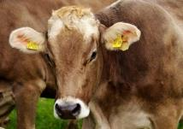

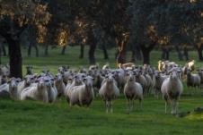
Topics for today
Relevance of CH₄
Emission mechanism
Excretion of manure
Potential emissions
Methane conversion factor (MCF)
Summary

Slide 3
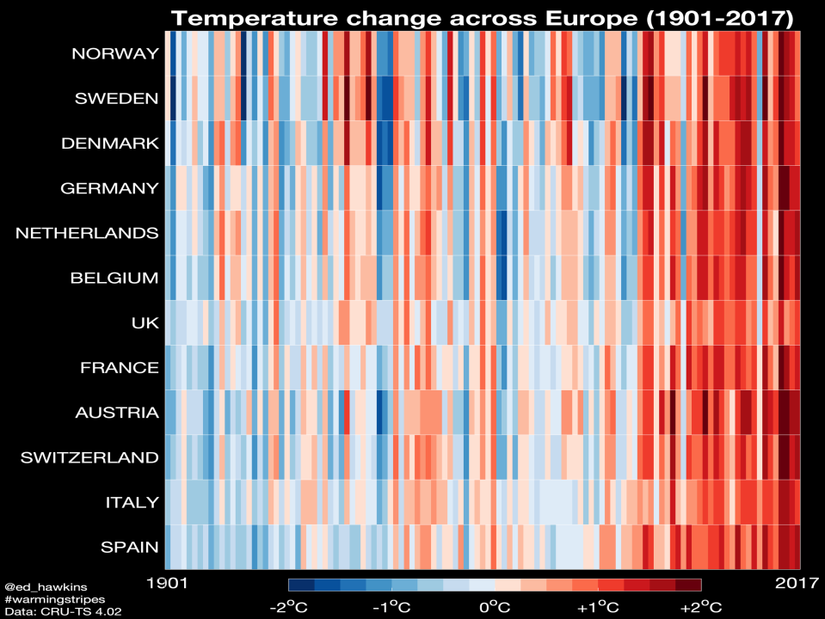

Slide 4
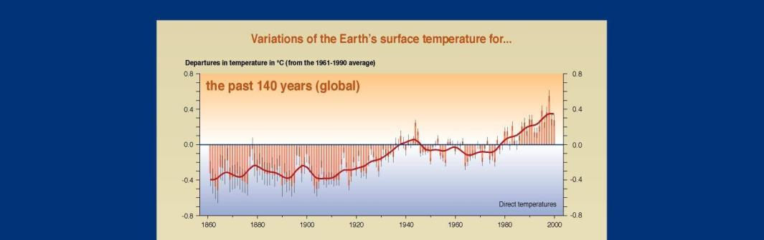
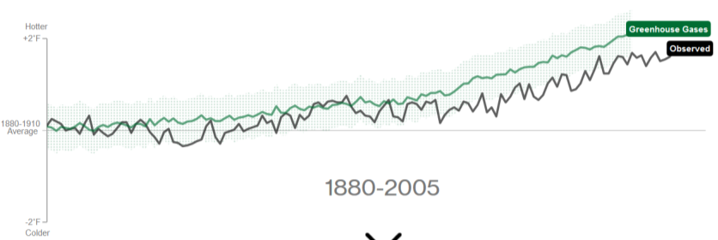
https://www.bloomberg.com/graphics/2015-whats-warming-the-world/

Slide 5
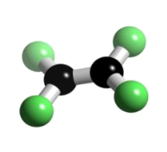
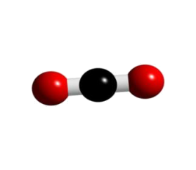
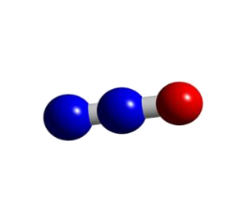
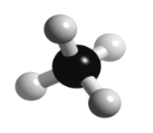
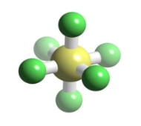
Greenhouse gases (GHG)
Wide variety of GHG.
C₂F₄ (CFC)
CO₂
SF₆
…
CH₄
N₂O

Slide 6
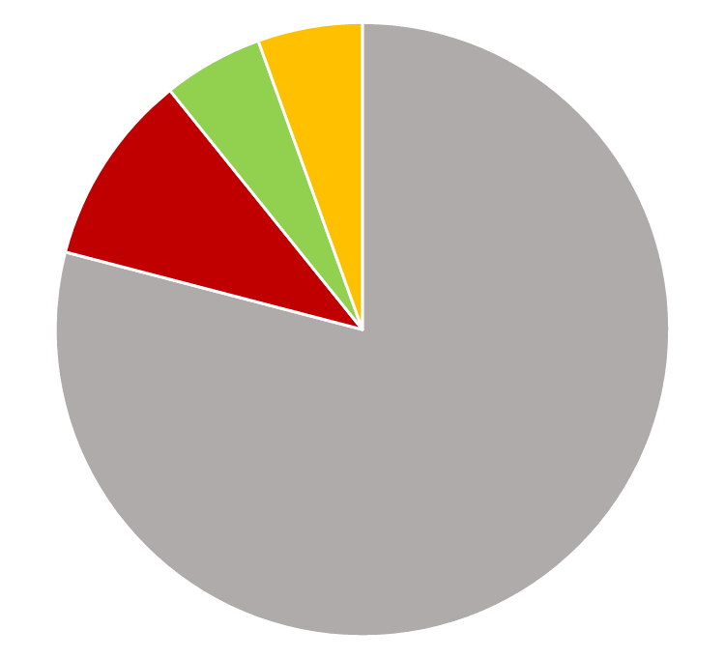
Total amount of GHG (Europe)
Gas | Emission (Tg/y) | % of total
CO₂ | 3,489 | 79%
CH₄ | 448 | 10%
N₂O | 233 | 5%
Rest | 243 | 6%
https://www.eea.europa.eu/data-and-maps/data/data-viewers/greenhouse-gases-viewer

Slide 7
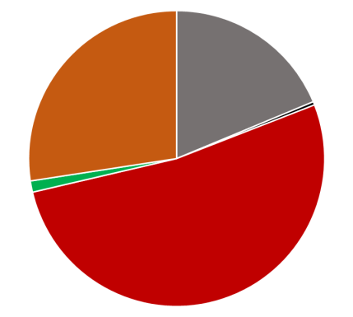
CH₄ by sector
Sector | CH₄ (Tg/y) | % of total
Energy | 85 | 19%
Industry | 2 | 0.4%
Agriculture | 237 | 52%
Land use | 6 | 1.2%
Waste | 124 | 27%
https://www.eea.europa.eu/data-and-maps/data/data-viewers/greenhouse-gases-viewer

Slide 8
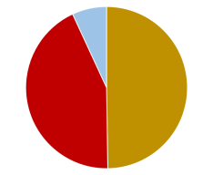
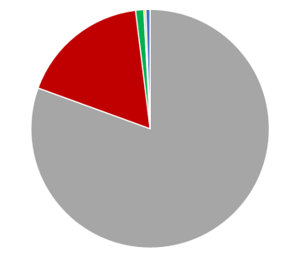
CH₄ by sector
Manure ~ 1% of EU GHG
Sector | CH₄ (Tg/y) | % of Agriculture
Enteric fermentation | 191 | 81%
Manure | 41 | 17%
Agriculture | 2.6 | 1.1%
Land use | 0.6 | 0.3%
Waste | 1.4 | 0.6%
https://www.eea.europa.eu/data-and-maps/data/data-viewers/greenhouse-gases-viewer

Slide 9
Global Warming Potential
 | Relative Warming Potential | Lifetime (years)
CO₂ | 1 | 5-200
CH₄ | 21 | 12
N₂O | 298 | 114
HFC-134 | 1.300 | 13,8

Slide 10

The Horizon

Slide 11
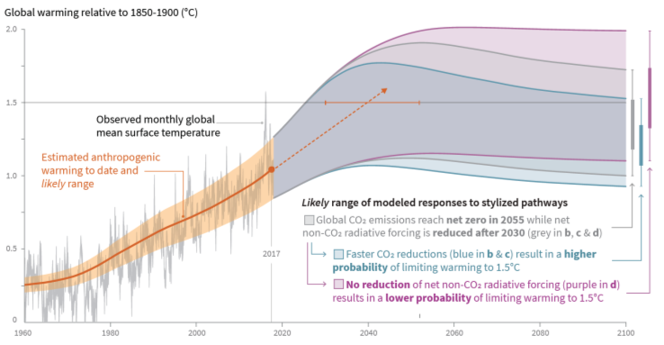
The Horizon
http://www.ipcc.ch/report/sr15/
The role of non-CO₂ emissions.

Slide 12
Topics for today
Relevance of CH₄
Emission mechanism
Excretion of manure
Potential emissions
Methane conversion factor (MCF)
Summary

Slide 13
Methane (CH4)
Enteric fermentation
Manure management

Slide 14

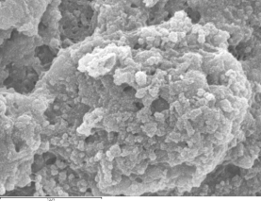


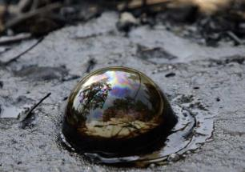
Origin of CH₄
O2
Organic matter
CH4
CO2

Slide 15
Organic matter
Absence of oxygen
No inhibitions
Time
Mechanism
Carbohydrates, Proteins, Lipids
hydrolysis
Primary fermentative bacteria (acidogens)
Sugars, amino acids, fatty acids, alcohols
Acidogenesis
Volatile fatty acids, simple alcohols
Secondary fermentative bacteria (acetogens)
Acetogenesis
Homoacetogenesis
Acetate
H₂ + CO₂
Aceticlastic methanogenic archaea
Methanogenesis
Hydrogenothrophic methanogenic archaea
CH₄ + CO₂

Slide 16
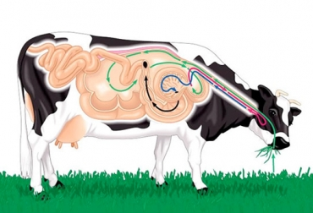
Origen de las emisiones
Enteric fermentation
Ym = % of Energy intake emitted as CH₄
IPCC Guidelines
https://www.ipcc-nggip.iges.or.jp/public/2006gl

Slide 17
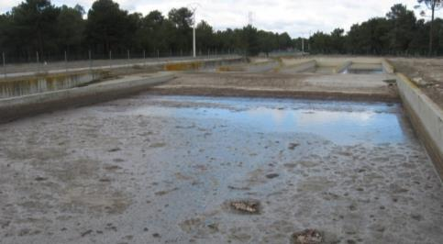
Origen de las emisiones
Manure management
VS excretion
(kg/animal/yr)
B₀ = BMP (m³ CH₄/kg VS)
Biochem. CH₄ Potential
MCF (%)
CH₄ conversion factor
CH₄ (kg/yr) = VS x B₀ x MCF x 0.67 kg/m³
IPCC Guidelines
https://www.ipcc-nggip.iges.or.jp/public/2006gl

Slide 18
Topics for today
Relevance of CH₄
Emission mechanism
Excretion of manure (VS)
Potential emissions (B₀)
Methane conversion factor (MCF)
Summary

Slide 19
Origen de las emisiones
Energy balance at animal level
Gross energy
Faeces (Organic Matter = Volatile Solids)
Digestible energy
Urine, enteric CH₄
Metabolizable energy
Heat
Net Energy
Nutrient balances

Slide 20
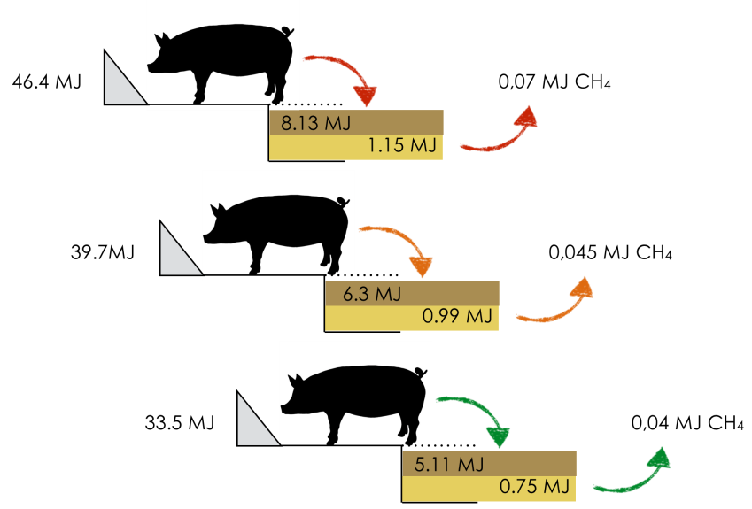
Energy balance at animal level (research)
MJ EB/kg LW increase
Antezana et al., 2018

Slide 21

Origen de las emisiones
Energy balance at animal level (inventory)
Depend on:
- Type of feed
- Type of animal
- Management
Animal Category | VS (kg/place/yr)
Piglets (6-20 kg) | 43
Fatteners (20-49 kg) | 131
Fatteners (50-79 kg) | 161
Fatteners (80-109 kg) | 180
Fatteners (> 110kg) | 204
Boars | 249
Pregnant sow | 229
Farrowing sows | 414

Slide 22
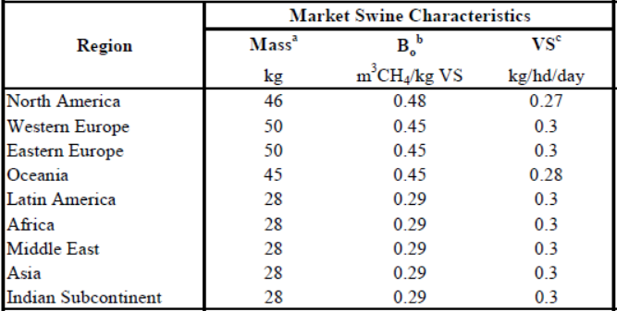
Origen de las emisiones
IPCC default values for VS excretion
IPCC Guidelines
https://www.ipcc-nggip.iges.or.jp/public/2006gl

Slide 23
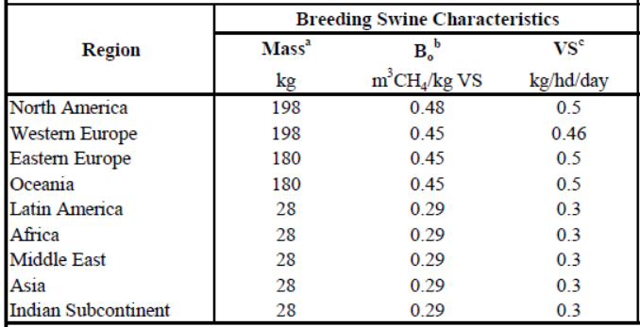
Origen de las emisiones
IPCC default values for VS excretion
IPCC Guidelines
https://www.ipcc-nggip.iges.or.jp/public/2006gl

Slide 24
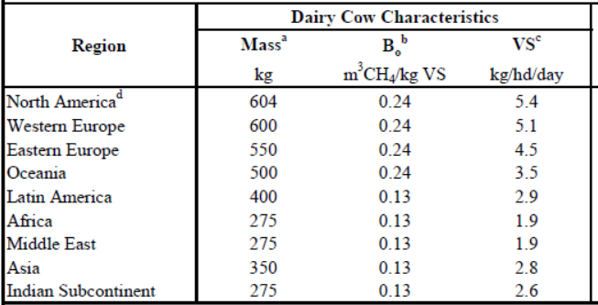
Origen de las emisiones
IPCC default values for VS excretion
IPCC Guidelines
https://www.ipcc-nggip.iges.or.jp/public/2006gl

Slide 25
Topics for today
Relevance of CH₄
Emission mechanism
Excretion of manure (VS)
Potential emissions (B₀)
Methane conversion factor (MCF)
Summary

Slide 26
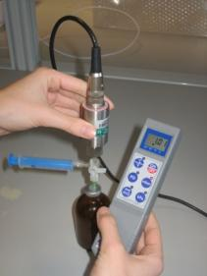
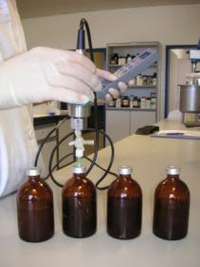
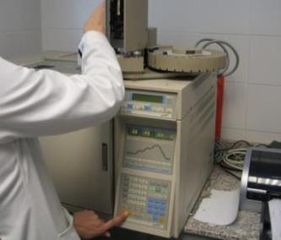
Origen de las emisiones
Biochemical Methane Production (BMP, B₀)
“a laboratory batch digestion of the substrate in the presence of an anaerobic inoculum, at a certain inoculum to substrate ratio” (from Angelidaki et al., 2009).

Slide 27
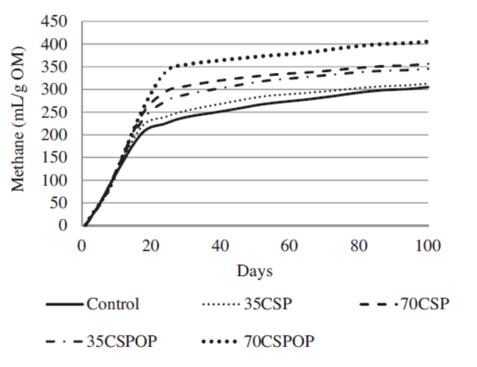
Origen de las emisiones
Biochemical Methane Production (BMP, B₀)
Antezana et al., 2015

Slide 28

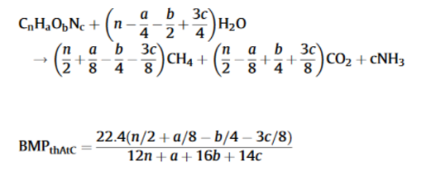

Origen de las emisiones
Prediction of BMP (from composition)
Chemical Oxygen Demand (COD)
Elemental composition
(C, O, H, N)
Organic fraction composition
NIRS (Near Infra Red Spectroscopy)
Nielfa et al., 2015; Ward, 2016

Slide 29
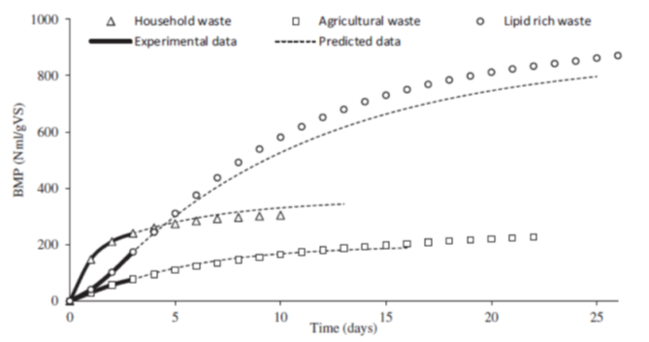
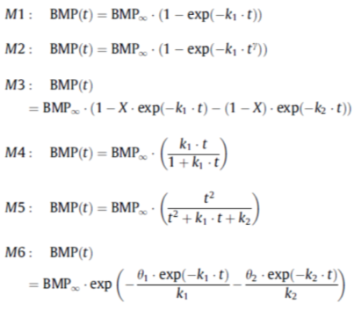
Origen de las emisiones
Prediction of BMP (from kinetics)

Slide 30
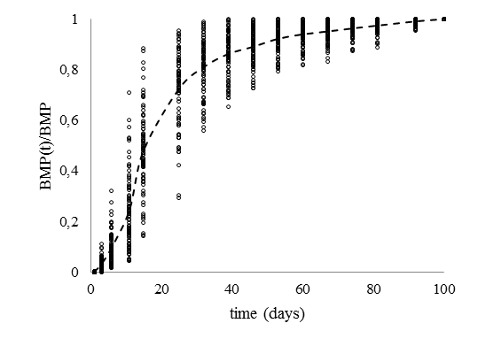
Origen de las emisiones
Prediction of BMP (from composition)

Slide 31
Topics for today
Relevance of CH₄
Emission mechanism
Excretion of manure (VS)
Potential emissions (B₀)
Methane conversion factor (MCF)
Summary

Slide 32
Origen de las emisiones
MCF values depending on many factors
• Timing of storage/application;
• Feed and animal characteristics
• Length of storage
• Manure characteristics
• Amount of manure left (inoculum);
• Temperature distribution (spatial, time)
IPCC Guidelines
https://www.ipcc-nggip.iges.or.jp/public/2006gl

Slide 33
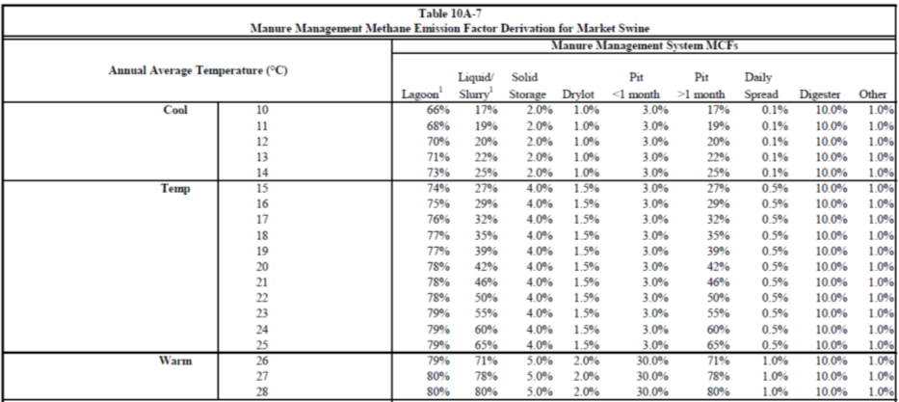
MCF by temperature and management
IPCC Guidelines
https://www.ipcc-nggip.iges.or.jp/public/2006gl

Slide 34
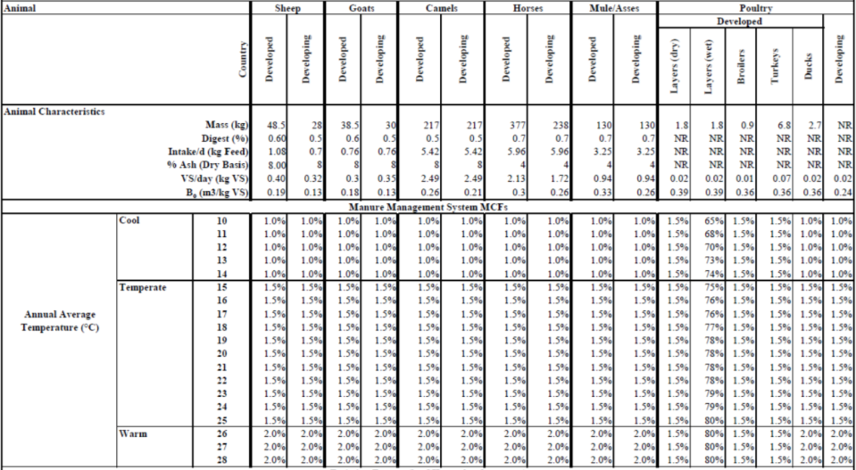
MCF by temperature and management
IPCC Guidelines
https://www.ipcc-nggip.iges.or.jp/public/2006gl

Slide 35
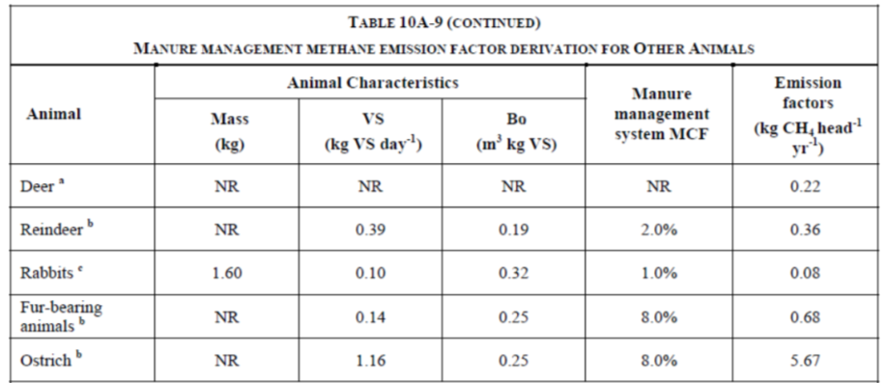
MCF by temperature and management
IPCC Guidelines
https://www.ipcc-nggip.iges.or.jp/public/2006gl

Slide 36
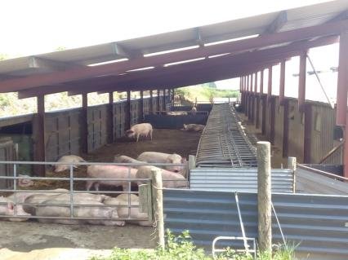
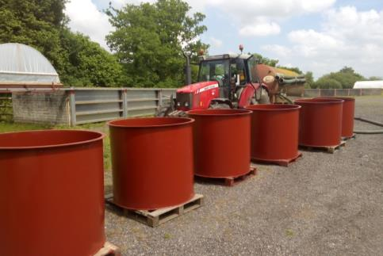
Example: effect of aeration
Pig farm
Fattening pigs
6 m³ slurry
6 tanks, 1m³ each
3 control
3 aeration
Calvet et al., 2017

Slide 37
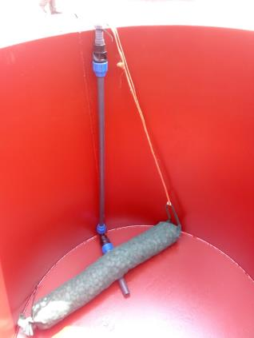
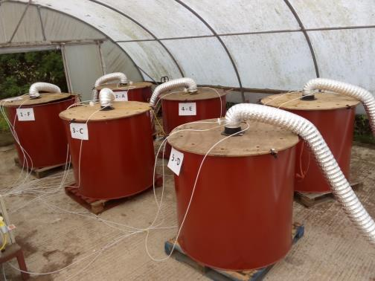
Example: effect of aeration
Aeration
2 minutes every 6h
(3, 9, 15, 21h), 10 m3/h
Calvet et al., 2017

Slide 38
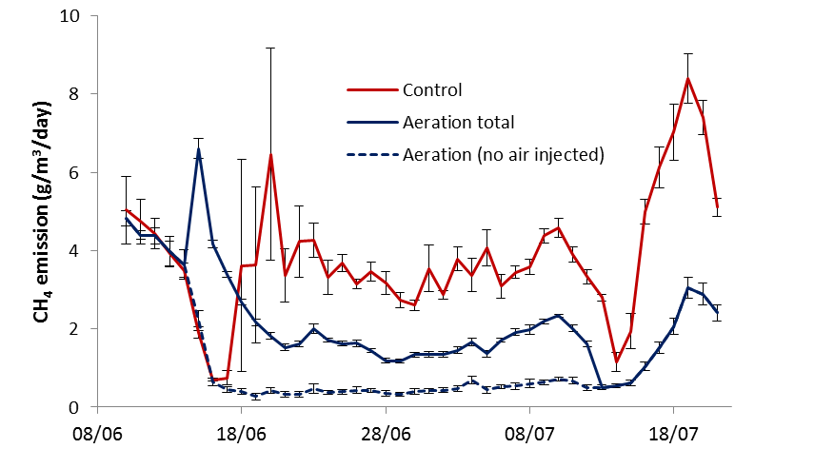
Example: effect of aeration
Phase 1
No aeration
Phase 2
Aeration
Phase 3
No aeration
Calvet et al., 2017

Slide 39
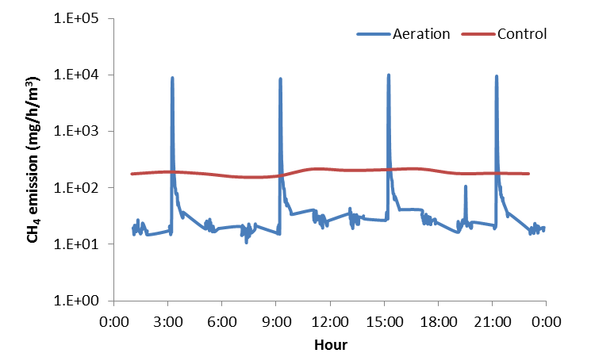
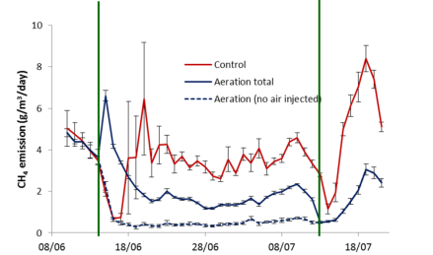
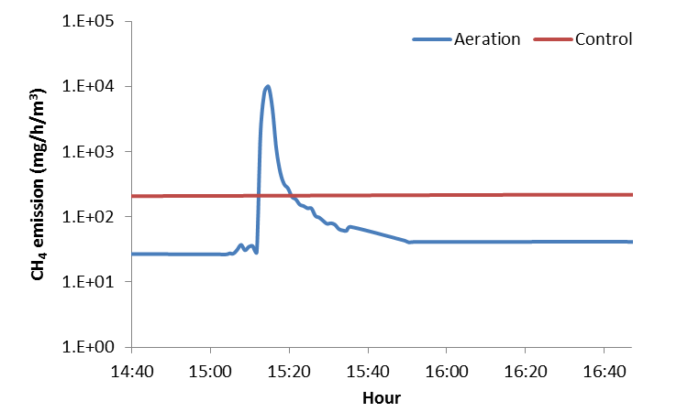
Example: effect of aeration
Log scale!
Log scale!
Aeration
2 minutes
Calvet et al., 2017

Slide 40
Topics for today
Relevance of CH₄
Emission mechanism
Excretion of manure (VS)
Potential emissions (B₀)
Methane conversion factor (MCF)
Summary

Slide 41
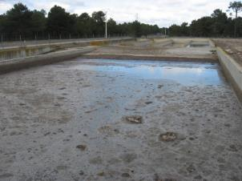
Origen de las emisiones
Calculated manure from pig slurry
VS excretion ~ 160 kg/place/year
B₀ ~ 300 L CH₄ / kg VS
MCF ~ 0 (solid manures)
>50% (slurries)
Depending on temperature
Up to ~ 7 kg CH₄ per m³ of slurry
About ~200 kg CO₂ _{eq} per fattener produced

Slide 42
Origen de las emisiones
Modelling perspectives
VS Excretion: Accurate with nutrition balances
BMP: Convenience for measured values
Can be estimated
MCF: Large variations
Factors critically affecting (T, management…)
More information needed

Slide 43
Methane emissions depending on manure management
Salvador Calvet Sanz
Institute of Animal Science and Technology
Universitat Politècnica de València
salcalsa@upvnet.upv.es
@SalvaCalvet

